Slide 1

North Korea CTI Brief

Slide 2
North Korea CTI Brief
Kyle Diamond Model

Slide 3
North Korea CTI Brief
Capabilities && Intent > Threat

Slide 4
North Korea CTI Brief
WannaCry
Exploited a Microsoft vulnerability in the Server Message Block.
Patch was issued in Mar, 2017 that disallowed this functionality.
Was sent though phishing techniques that needed the user to click on the payload.
The virus was propagated through the network by infecting one computer and then moving through the network with work-like capabilities.

Slide 5
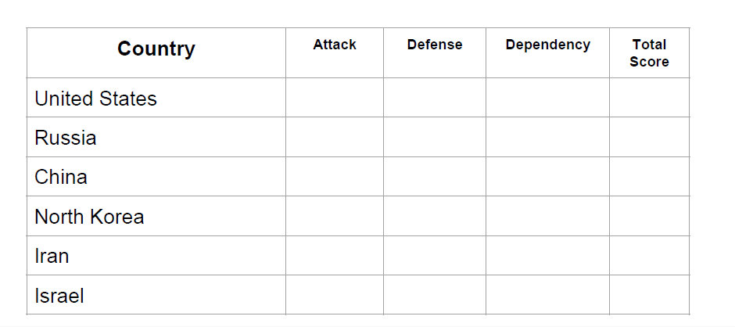
North Korea CTI Brief
Relative Cyber Power Threat

